Slide 1
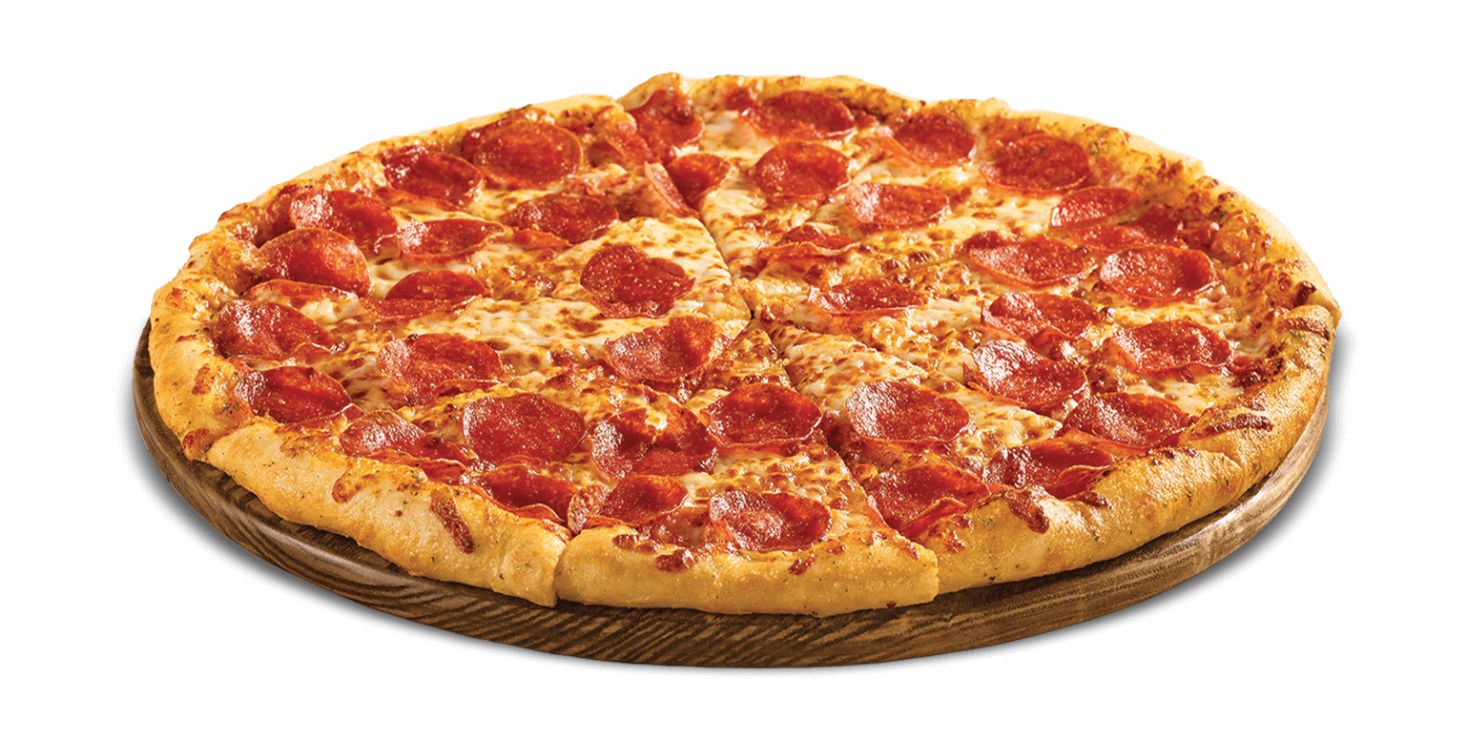
PIZZA
Notes:
Pizza is a favorite dish to many people. It is also one of my favorite foods that I enjoy most.

Slide 2
INTRODUCTION
Using too many toppings
Setting oven temperatures low
Notes:
As I was preparing I realized that I had made two mistakes. I had put so many topping on the pizza and I also set the oven temperatures low at 350°F.

Slide 3
OBJECTIVE
Using too many toppings
https://www.youtube.com/watch?v=Ww6H1wE4boc
Setting oven temperatures low
https://www.youtube.com/watch?v=1oWgFvjBLbQ
Notes:
Using many toppings on pizza makes it to be unevenly cooked. Setting low temperatures of 350°Fm on the oven makes pizza to have a soggy crust

Slide 4
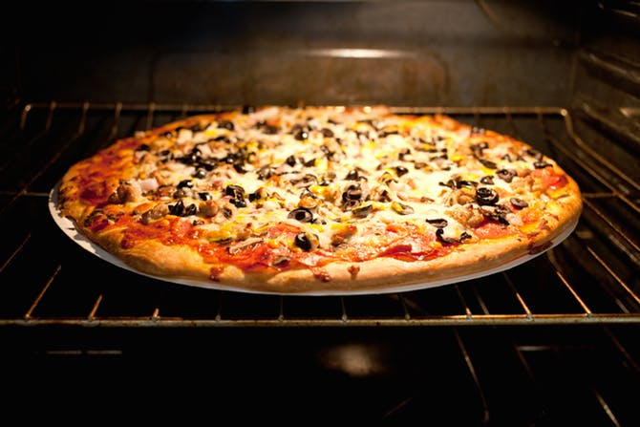
SOLUTION
Using few toppings
Setting a high oven temperature of 500°F
Notes:
Using few toppings makes pizza to be evenly cooked and setting a high oven temperature ensures that the pizza cooks quickly

Slide 5
DMAIC
Define: Using many toppings and Setting oven temperatures low
Measure: unevenly cooked pizza
Analyze: Setting an oven temperature attractive golden crust.
Improve: Using few toppings and Setting oven temperatures high
Control: practice cooking to perfect my skills
Notes:
When I cooked using many toppings with low oven temperatures, pizza turned out to be unevenly cooked. if I could have used few toppings and high temperatures, the pizza have been perfect. During my second cooking, I will not make the same mistakes again.

Slide 6
CONCLUSION
Use few toppings
Make oven temperatures high
Notes:
Make sure you use few toppings and high oven temperatures to get a tasty pizza.

